Slide 1
General Structural Overview of a Modular Design

Slide 2
General Structural Overview of a Modular Design
Measured data
Reference data (background state)
Formula
Background
Input
Orchestration layer / API
Parameters
DD
Scale
2Theta shift
Macro?
Calc backgrnd
LPA
Shared Services / UI / Licensing/ plotting
output
Measured profile
Calculated profiles
Scale factors + goodness of fit+offset
Quantities – FP drift correction

Slide 3
Launch and road map for XpC transmission targeted at Pharma
Launch
XpC Transmission Benchtop
Road Map
Sample holders
Sample prep kit
Auto Sample Prep
Training materials
Webinar
White Papers
Marketing
Applications deck
E book.
Capillary holders
Sample prep kit
Training materials
Webinar
White Paper
Marketing
Applications deck
E book.
Non ambient
Sample prep kit
Training materials
Webinar
White Paper
Marketing
Applications deck
E book.
Well Plate
Sample prep kit
Training materials
Webinar
White Paper
Marketing
Applications deck
E book.

Slide 4
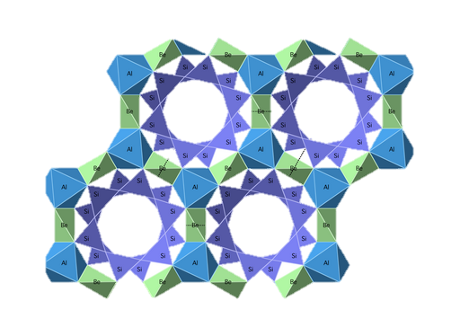

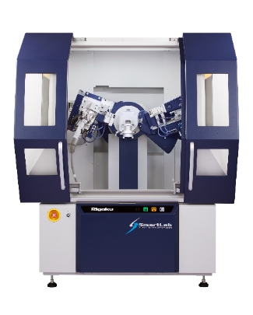

Genesis in Practice: AI materials discovery loop
Verify
Check the actual material structure
Synthesize candidates
Autonomous cycle
Guide
Learn
Predict a recipe for ideal material
Notes:
Genesis is about accelerating materials discovery with AI. In practice, that means running a fast loop between prediction, experimentation, and learning.
The most common failure mode is not the AI. It’s slow or inconsistent measurement and poorly structured data.
Our role is in the measurement-and-workflow layer that makes the loop reliable and scalable.

Slide 5
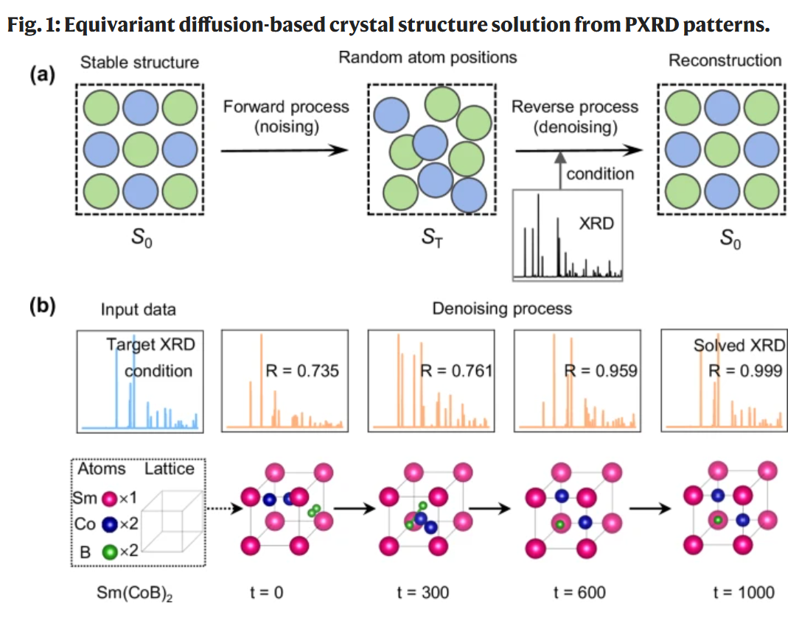

Slide 6
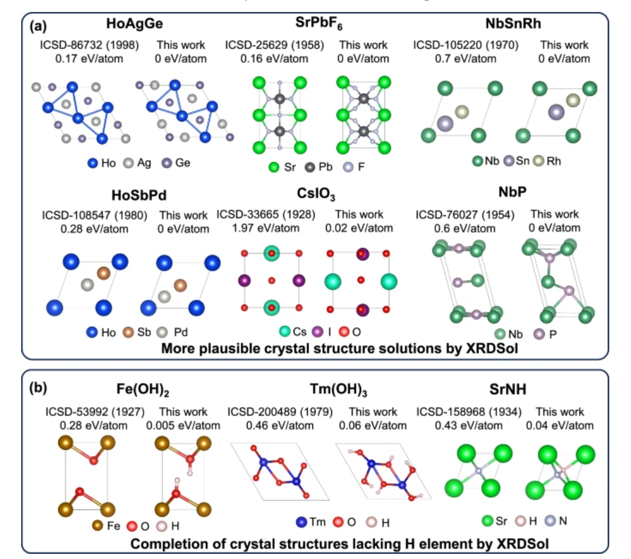

Slide 7
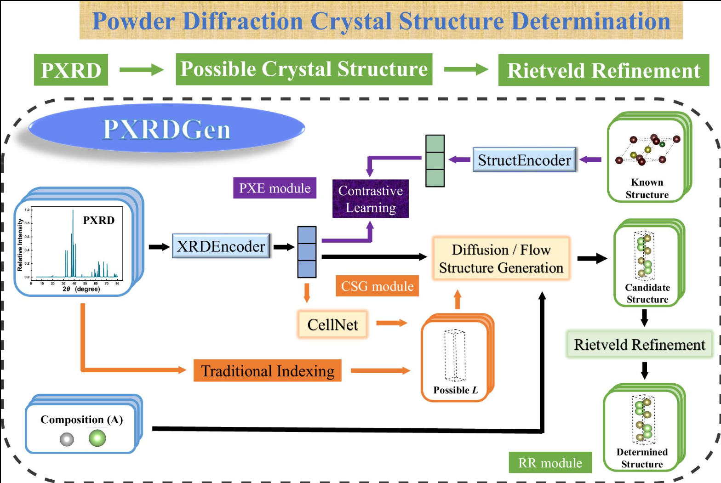

Slide 8
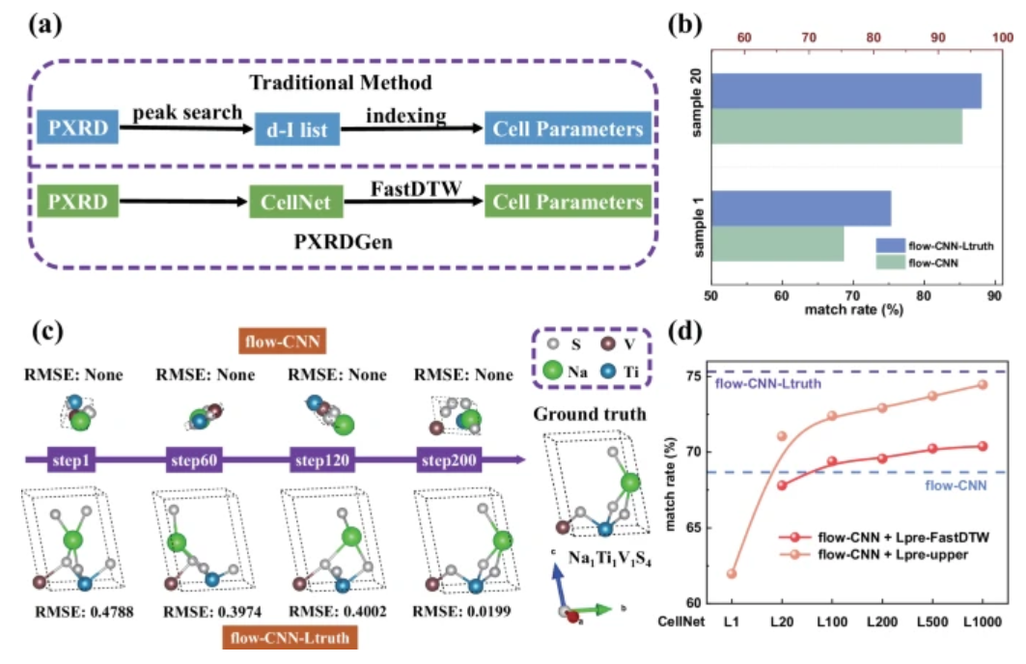

Slide 9
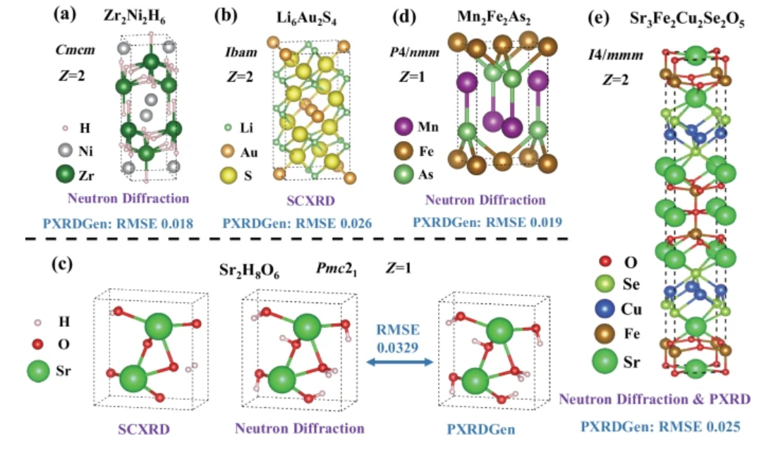

Slide 10
